Slide 1
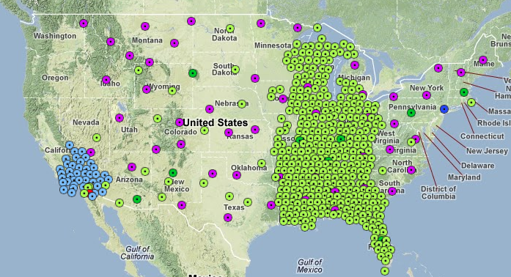
Seismology with Large Continental Arrays
Mike Ritzwoller
CU-Boulder
Department of Physics
Students & Post-Docs:
Yingjie Yang (Macquarie U.)
Morgan Moschetti (USGS)
Fan-Chi Lin (Caltech)
Weisen Shen
Jiayi Xie
Tian Ye
USArray Transportable Array (TA) on Oct 3, 2012
Notes:
Illustrates the length scales of structures that are being resolved.
Slower in the west than the east, of course – but significant variability across the entire region.
Many features recongizable: Snake R. Plain, Rocky Mtns, Columbia Plateau, volcanic rim of the CO Plateau, Mid-Continental Rift, Superior Province, etc.
Talk is about how to construct such images and use them quantitatively to produce a 3D model.

Slide 2
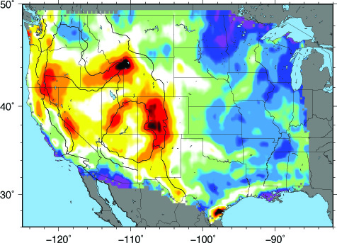
Seismology with Large Continental Arrays
Mike Ritzwoller
CU-Boulder
Department of Physics
Students & Post-Docs:
Yingjie Yang (Macquarie U.)
Morgan Moschetti (USGS)
Fan-Chi Lin (Caltech)
Weisen Shen
Jiayi Xie
Tian Ye
28 s Rayleigh wave phase velocity, ambient noise
Courtesy:
Weisen Shen
km/s
Notes:
Illustrates the length scales of structures that are being resolved.
Slower in the west than the east, of course – but significant variability across the entire region.
Many features recongizable: Snake R. Plain, Rocky Mtns, Columbia Plateau, volcanic rim of the CO Plateau, Mid-Continental Rift, Superior Province, etc.
Talk is about how to construct such images and use them quantitatively to produce a 3D model.

Slide 3
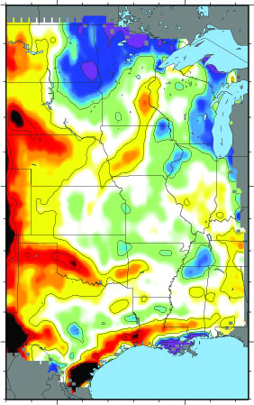
Seismology with Large Continental Arrays
Outline
Background: Frustrations of
“traditional” surface wave tomography.
Methodological enhancements:
Ambient noise tomography
“Flatland” -- observations
in 2D about 3D phenomena.
C. Bayesian Monte Carlo
Some results:
Isotropic structure across the US.
First glimpses of structures in the
Mid-West: Mid-Continental Rift
4. Bonus Material? – Az Anis in W US.
28 s Rayleigh wave
km/s

Slide 4
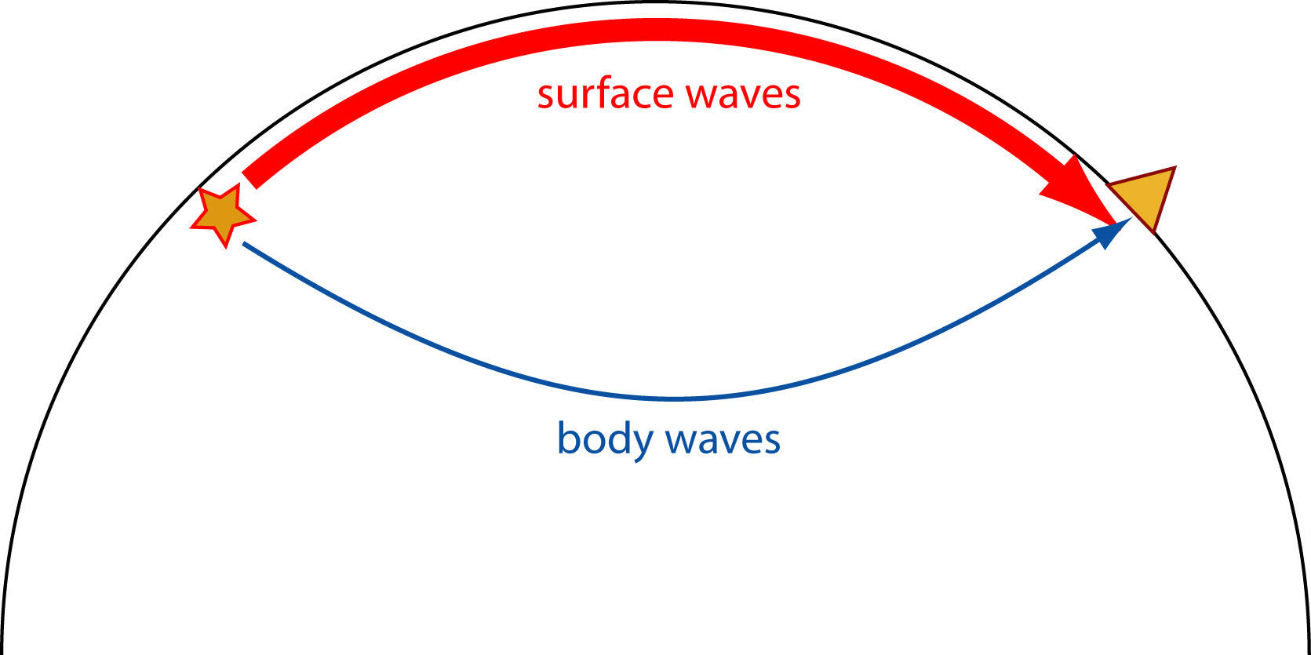
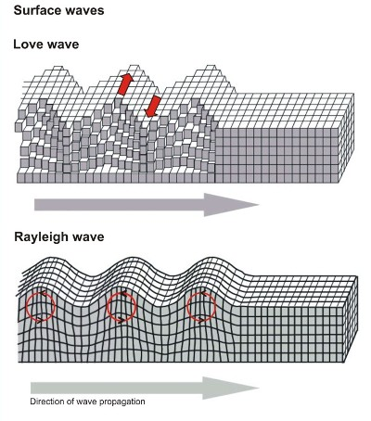
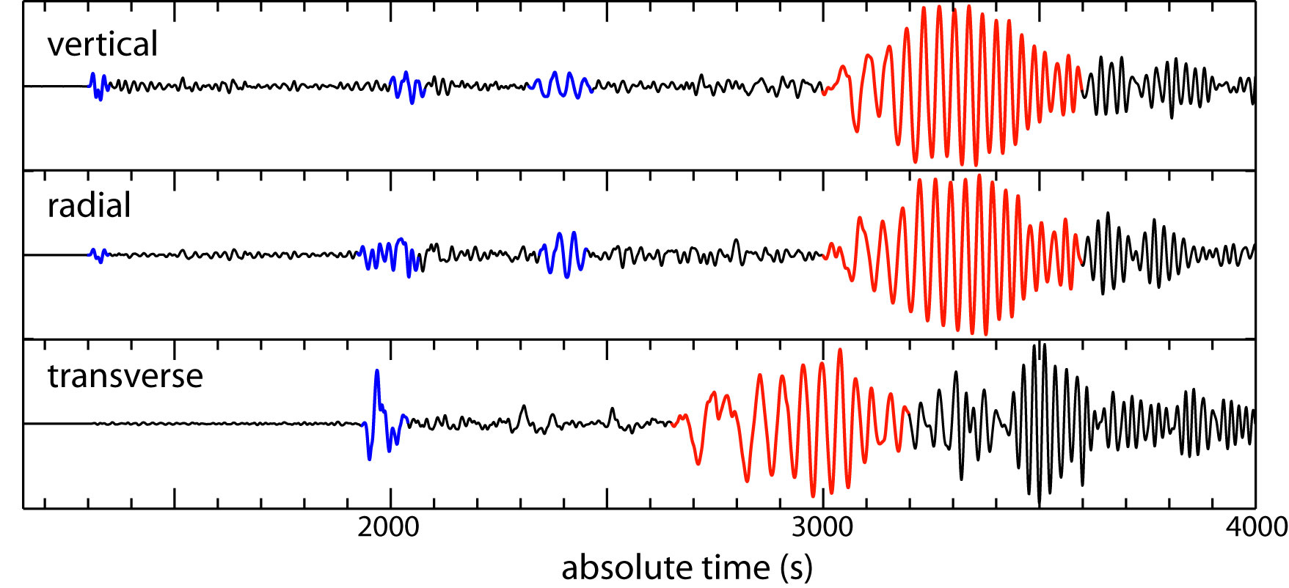
1. Some Background
Surface Waves: Rayleigh and Love
Dispersion
Phase and Group speed.
Body waves sample deep parts of the Earth
Surface waves sample the crust and upper mantle
P
S
P
S
S

Slide 5
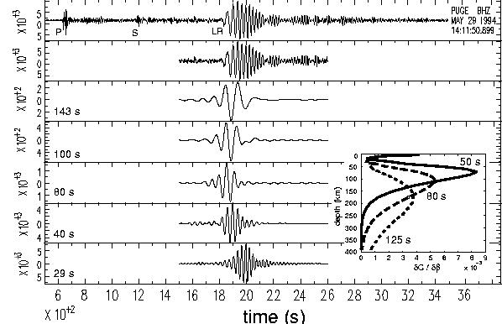
1. Some Background
Surface Waves: Rayleigh and Love
Dispersion
Phase and Group speed.
“Dispersive” characteristic of surface waves provides differential depth sensitivity – what gives depth resolution.
The broader the band of measurement the better.

Slide 6
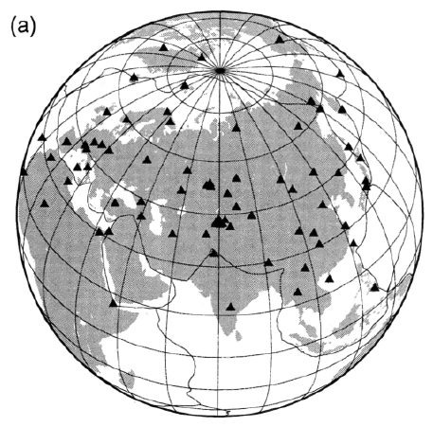
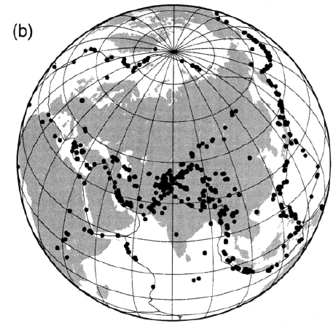
1. Some Background
Example of Traditional Analysis:
Ritzwoller & Levshin, JGR, 1998
stations
“Traditional” Surface Wave Tomography:
1. Distant earthquakes – waves travel a long way.
2. Globally installed stations, with a few national stations regionally.
3. Single station measurements.
4. Only long periods > 20 sec: only weak constraints on the crust.
events

Slide 7
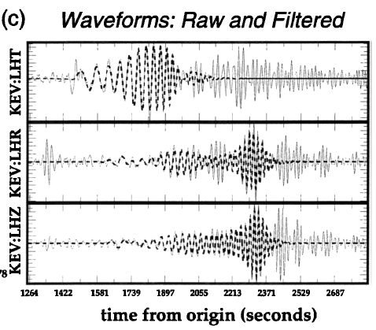
1. Some Background
Example of Traditional Analysis:
Ritzwoller & Levshin, JGR, 1998
stations
events

Slide 8
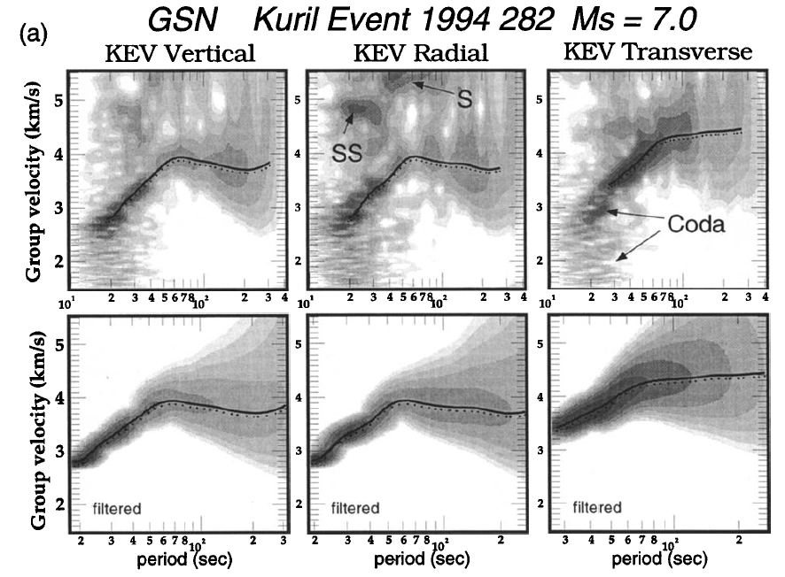
1. Some Background
Example of Traditional Analysis:
Ritzwoller & Levshin, JGR, 1998
stations
events

Slide 9
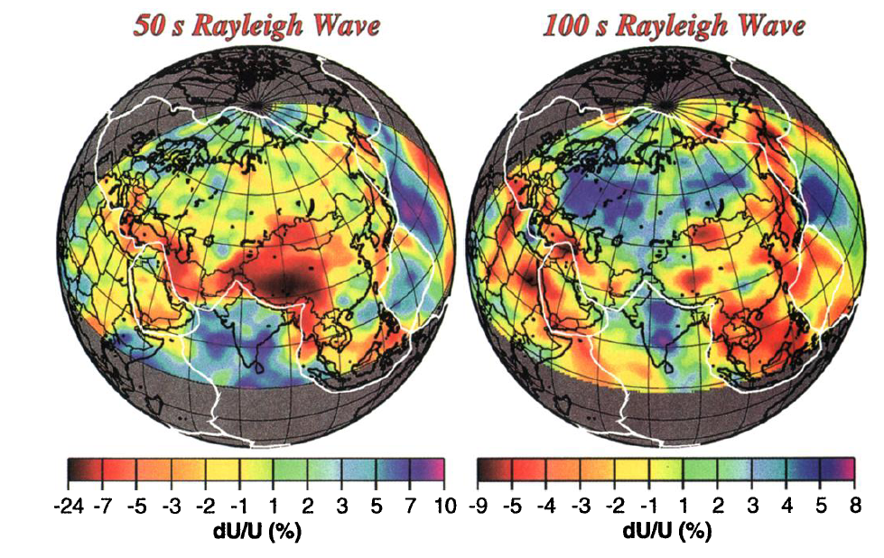
1. Some Background
Example of Traditional Analysis:
Ritzwoller & Levshin, JGR, 1998

Slide 10
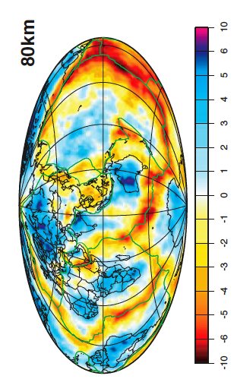
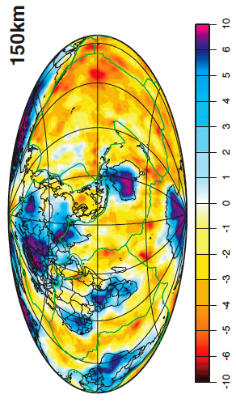
1. Some Background
Example of Traditional Analysis:
Shapiro & Ritzwoller, GJI, 2002
The method has been applied globally:
To image various upper mantle structures:
continental roots
subduction zones
variations in structure along mid-oceanic
ridges
.
.
.
To constrain the thermal structure of the
lithosphere and asthenosphere.
To improve regional event locations.

Slide 11
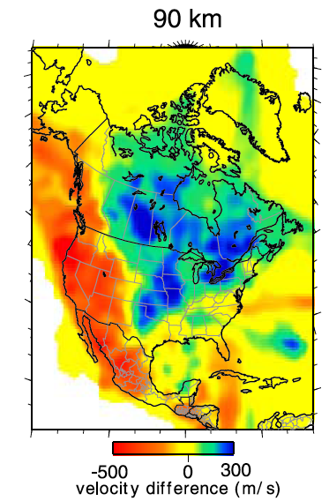
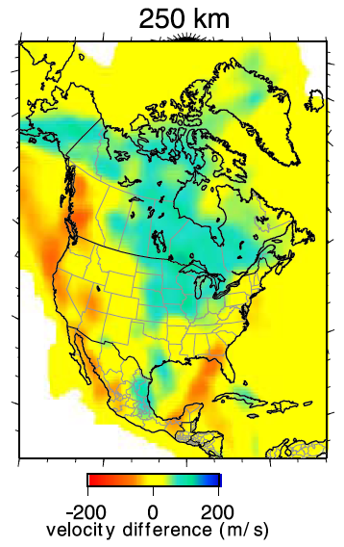
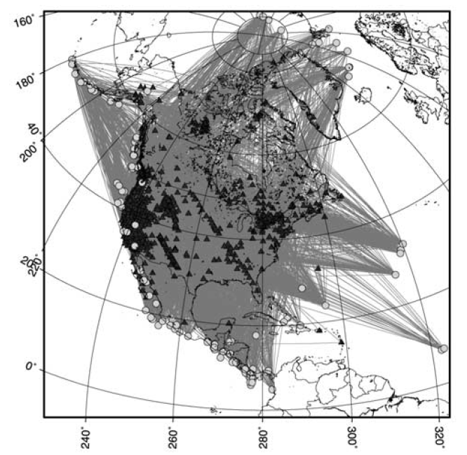
1. Some Background
Example of Traditional Analysis:
Bedle & van der Lee, JGR, 2009
NA07

Slide 12
1. Some Background
Frustrations of “Traditional” surface wave analysis:
Little information about the crust.
Lateral resolution is low:
sensitivity kernels are broad,
earthquakes recur in the same locations.
3. Vertical resolution is also low: Moho.
Tomography relies on ad-hoc choices of damping: anomaly amplitudes are unreliable, anisotropy is notoriously difficult to observe reliably.
Uncertainty analysis is often overlooked.
Easing the frustration:
Ambient noise tomography.
New methods of tomography that exploit dense continental arrays.
3. Joint inversion with receiver functions.
4. New methods of tomography based on “local inversion”.
5. “Local inversions” give uncertainties in dispersion maps, coupled with Bayesian MC methods.

Slide 13
2. Improvements in surface wave methodology
Ambient noise tomography
Idea of the method – demonstrate with a simulation.
Some plots of cross-correlations (empirical Green’s functions).
Derived observable: travel time fields.
B. “Flat Land” – new method to observe 3D structures from 2D arrays
Basic observables.
Localized inversion – eikonal, Helmholtz tomography.
Comparison of AN & EQ results.
C. Bayesian Monte Carlo Inversion

Slide 14
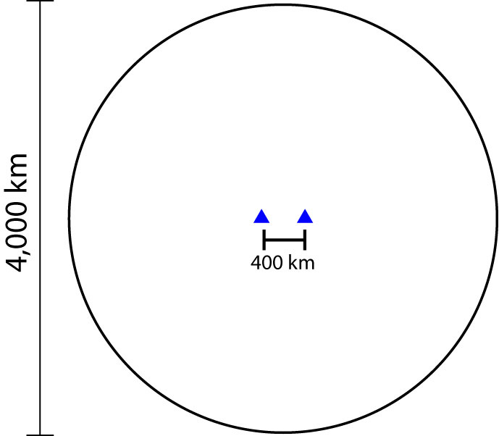
The Idea of the Method
Set-up of the
Simulation:
2 stations

Slide 15
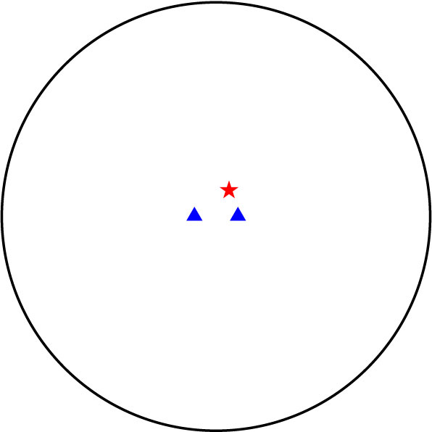
The Idea of the Method
Add a source

Slide 16
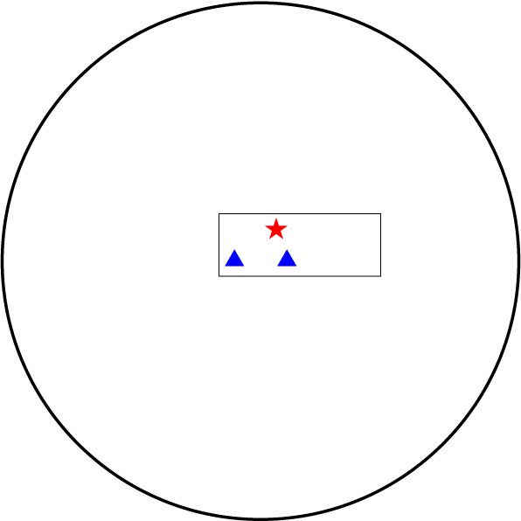
The Idea of the Method
Add a source
Zoom around
receivers

Slide 17
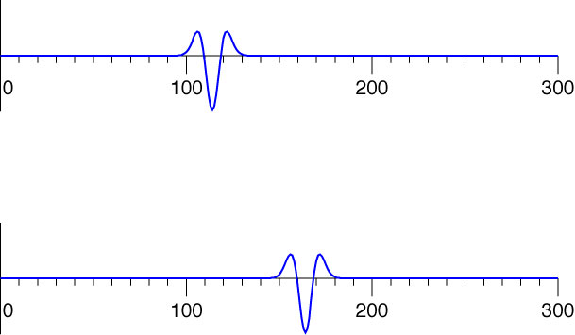
The Idea of the Method
1
2
2
time (sec)
1
time (sec)

Slide 18
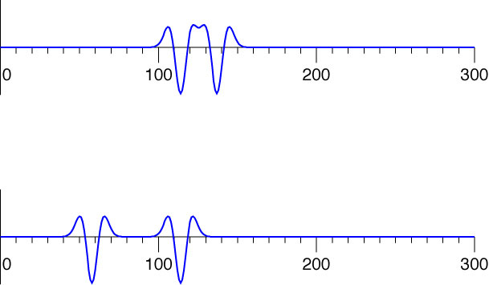
The Idea of the Method
Add another source randomly
1
2
2
time (sec)
1
time (sec)

Slide 19
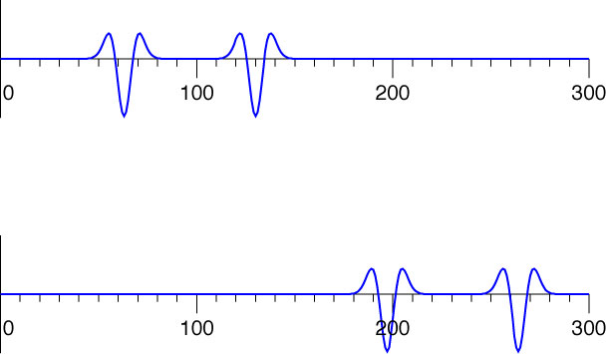
The Idea of the Method
Two sources in line with the stations
1
2
2
time (sec)
1
time (sec)

Slide 20
The Idea of the Method
2
time (sec)
1
2
1
time (sec)
Green function for
propagation between
the stations.
cross-
correlation
lag (sec)

Slide 21
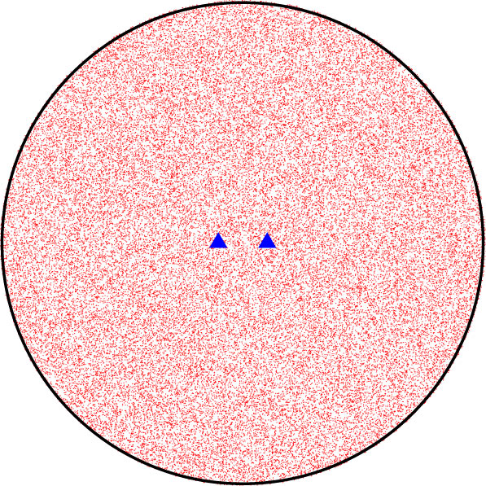
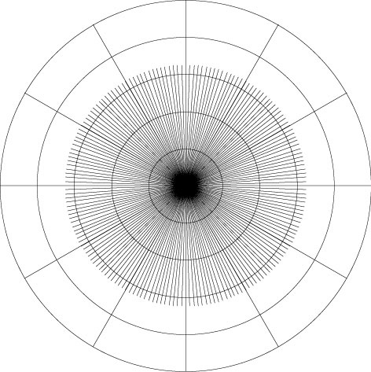
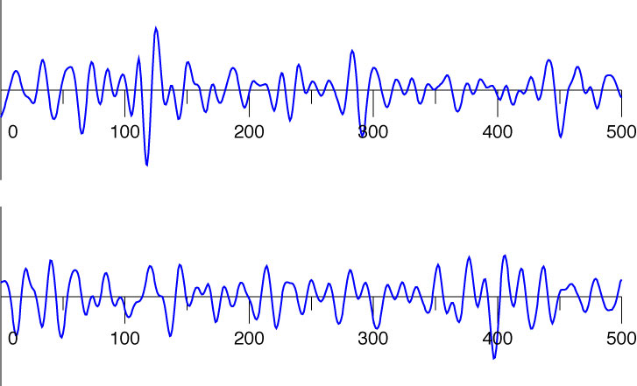
The Idea of the Method
1000s of
sources,
over 30
days
Azimuthally homogeneous
distribution of sources
2
time (sec)
1
time (sec)

Slide 22
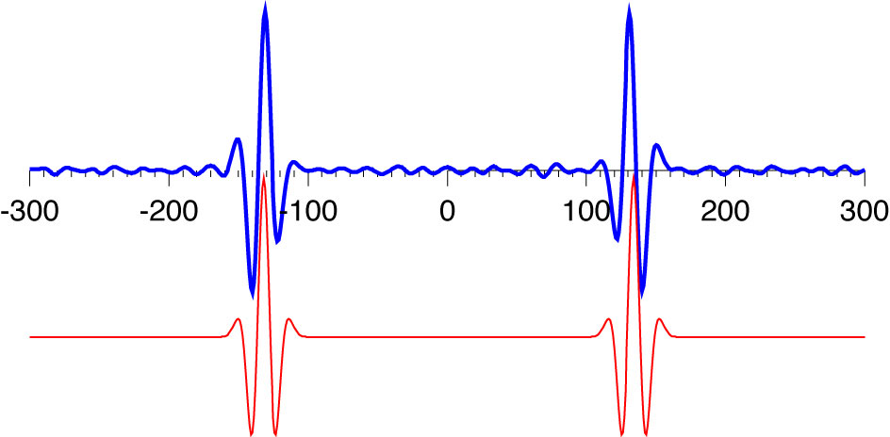
The Idea of the Method
1000s of
sources,
over 30
days
Azimuthally homogeneous
distribution of sources
cross-correlation
lag (sec)
theoretical Green function

Slide 23
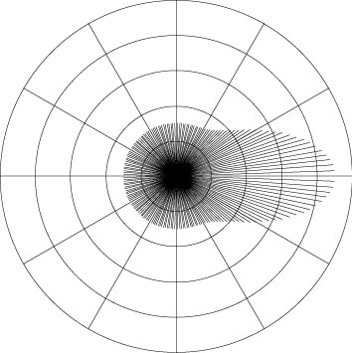
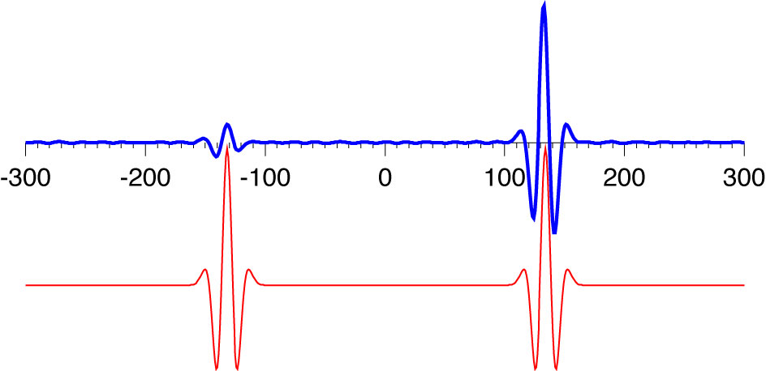
The Idea of the Method
1000s of
sources,
over 30
days
Azimuthally inhomogeneous
distribution of sources
cross-correlation
lag (sec)
lag (sec)
lag (sec)
theoretical Green function

Slide 24
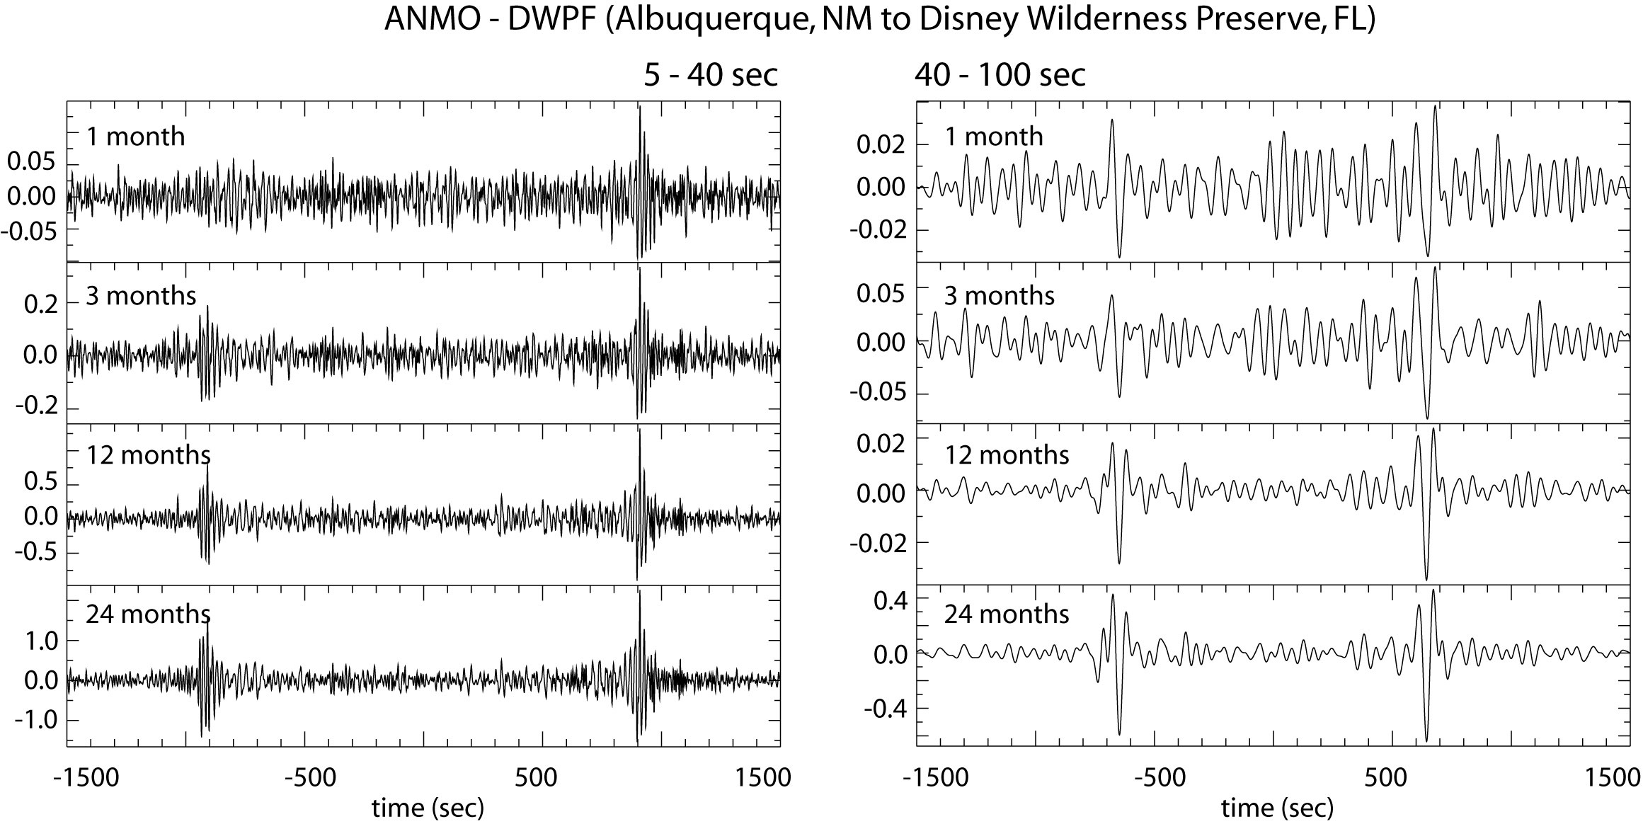
Longer time series are better
Bensen et al. (2007) GJI

Slide 25
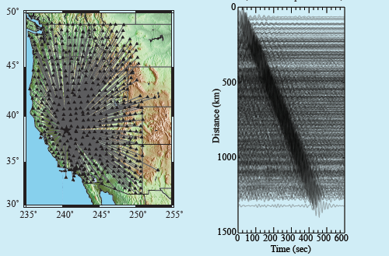
Example record section
15-30s bandpass filtered
R06C
Notes:
Ask Fan-chi about the time duration.

Slide 26
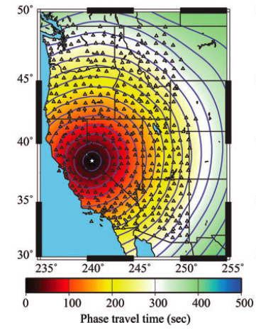
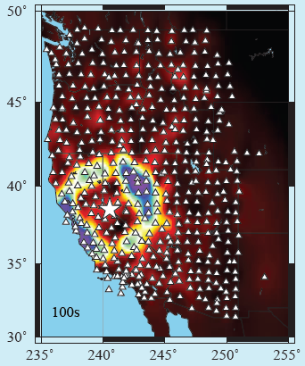
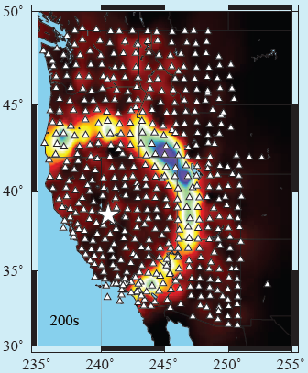
Example travel time field
15-30 bandpass filtered
28 sec Rayleigh wave
R06C
Notes:
Ask Fan-chi about the time duration.

Slide 27
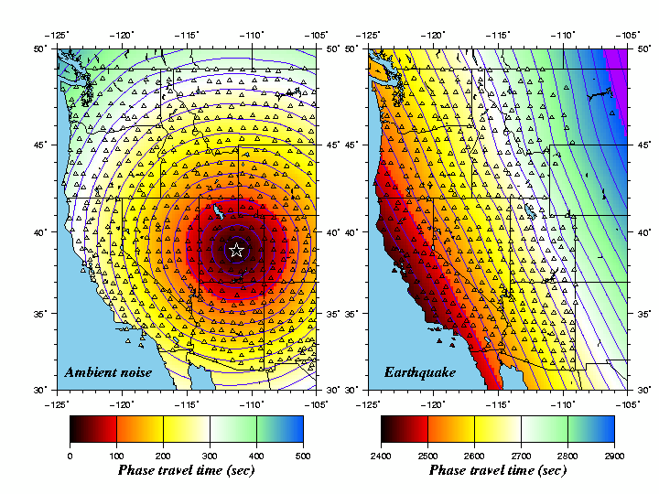
Example travel time field
Fundamental observable in ambient
noise tomography:
Travel time field for each central station at different periods for Rayleigh and Love waves.
Questions:
How do we use this information intelligently?
Can the same methods be applied to earthquake waves?
28 sec
Notes:
Ask Fan-chi about the time duration.

Slide 28
Example travel time fields
Fundamental observable in ambient
noise tomography:
Travel time field for each central station at different periods for Rayleigh and Love waves.
Questions:
How do we use this information intelligently?
Can the same methods be applied to earthquake waves?
28 sec
Earthquake:
Loyalty Is,
(9/28/07)
M=6.5
Notes:
Ask Fan-chi about the time duration.

Slide 29
2. Improvements in surface wave methodology
Ambient noise tomography
Idea of the method – demonstrate with a simulation.
Quick overview of data processing.
Some plots of cross-correlations (empirical Green’s functions).
Derived observable: travel time fields.
B. “Flat Land” – new method to observe 3D structures from 2D arrays
Basic observables.
Localized inversion – eikonal, Helmholtz tomography.
Comparison of AN & EQ results.
C. Bayesian Monte Carlo Inversion

Slide 30
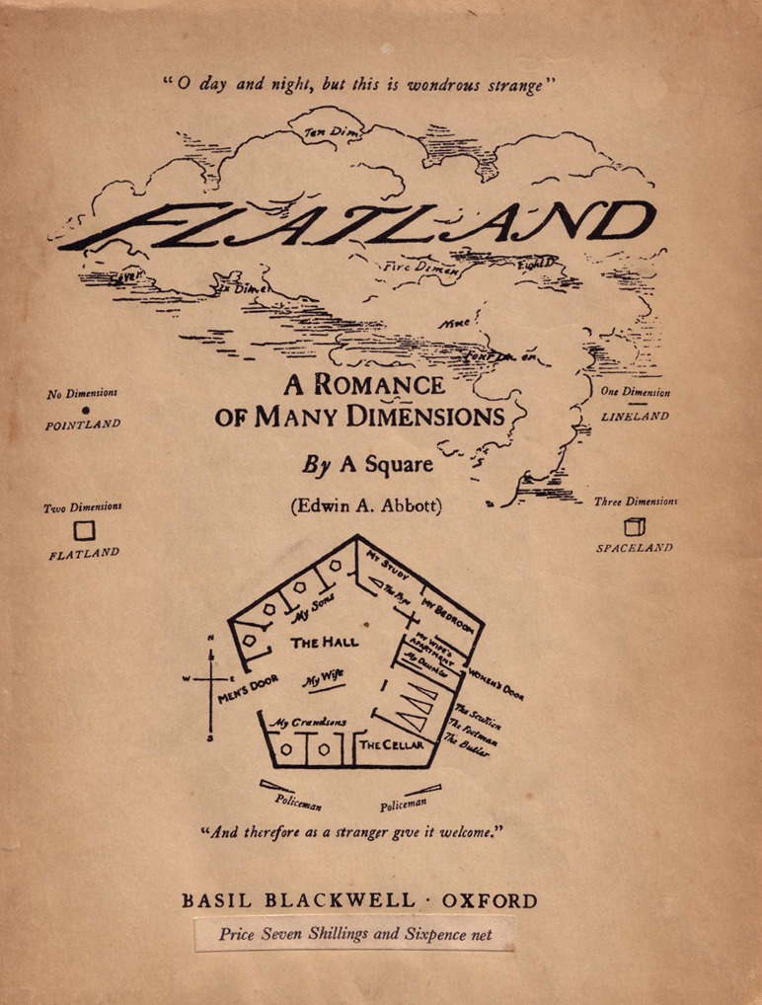
2. Improvements in surface wave methodology
Edwin Abbott (1884)
Social satire.
2D being experiences 3D phenomena:
a square experiences a sphere

Slide 31
“New” Tomographic Methology:
Guiding Principles: looking for methods that
model wave physics which may bias the results,
are straightforward to effect and use,
computationally inexpensive, and
produce estimates of uncertainties – so results can be combined with other kinds of data and used by other researchers.
Differences between ambient noise and earthquake imaging:
ambient noise (6-40 sec) is in a different but overlapping frequency band from
earthquake waves (25-80 sec),
ambient noise amplitude field is a complicated story,
earthquake waves require “finite frequency” corrections (performed
through amplitudes) because they’re longer period .
Gloss over the details and complications: but “the devil is in the details”.

Slide 32
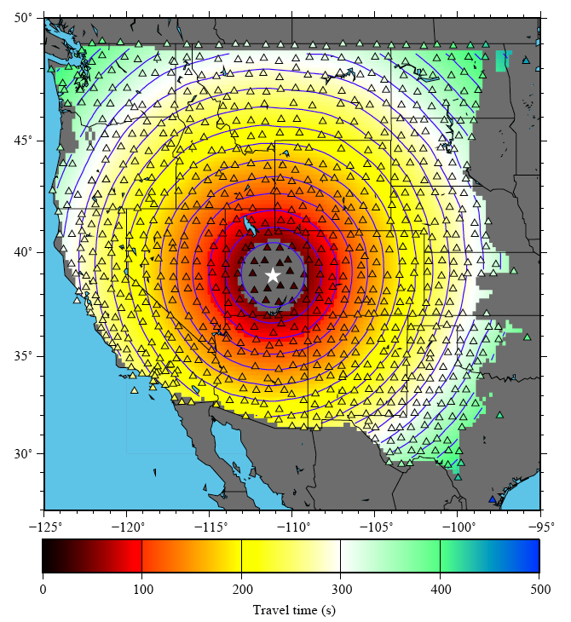
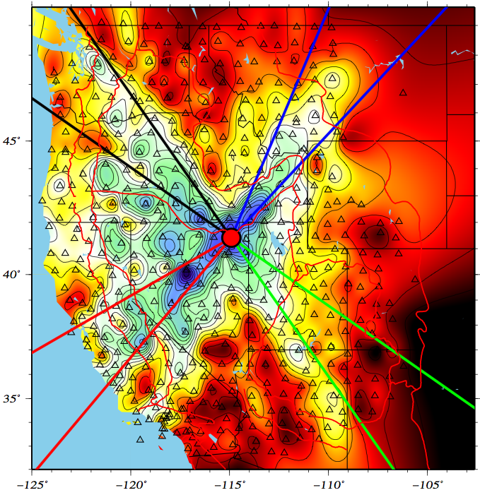
Basic Observables From Ambient Noise
Travel Time Field τ(r)
Amplitude Field A(r)
Currently
Unknown
24 s
Q16A
16 s
M12A
24 s
Q16A
symmetric
Tsai, V. C. (2011), Understanding the amplitudes of noise correlation measurements, J. Geophys. Res., 116, B09311, doi:10.1029/2011JB008483.
travel time (s) normalized amplitude

Slide 33
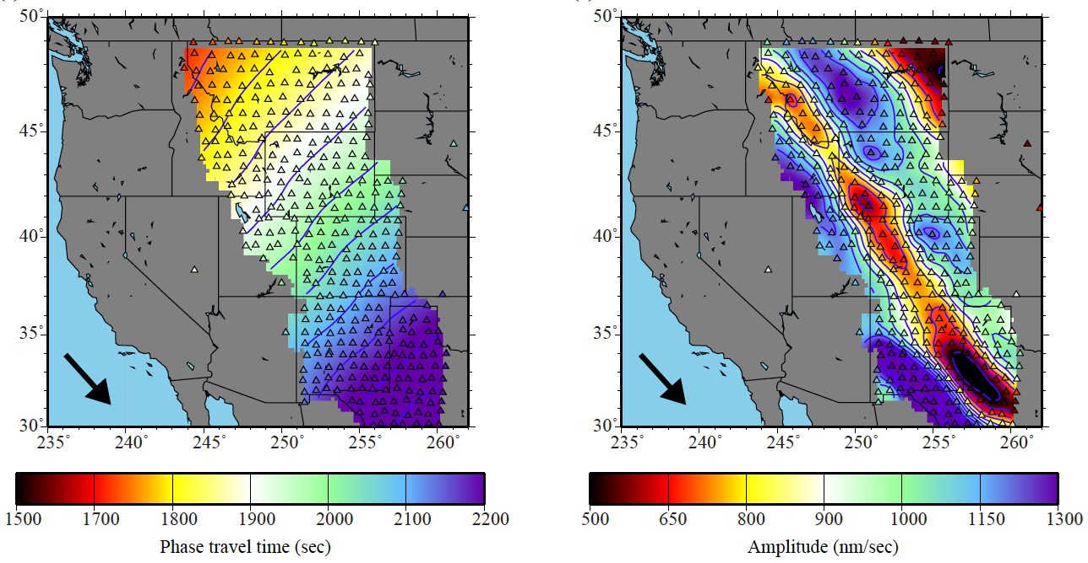
Basic Observables From An Earthquake
Travel Time Field τ(r)
Amplitude Field A(r)
60 s
Kuril Is Eq
7 Apr 2009
Ms = 6.8
Lin, F.C. and M.H. Ritzwoller, Helmholtz surface wave tomography for isotropic and azimuthally anisotropic structure, Geophys. J. Int., 186, 1104-1120, 2011.

Slide 34
“New” Methology:
Guided by the 2-D wave equation locally without inversion.
Normally:
Approximations are made.
Solutions for measurable quantities are in the form of integrals.
Inverse problem, undoes the effect of the solution – deintegrates.
Basis functions are global quantities.
Approach here:
Make measurements of the wavefield.
Interpret them locally guided by the wave equation.
There is no “solution” and no “deintegration”.
There is no “inversion”.
e.g. Wielandt, Friederich, Pollitz, Langston, Fan-Chi Lin

Slide 35
“New” Methology:
Guided by the 2-D wave equation locally without inversion.
Two step “inference”:
Step 1: Phase velocity maps produced by Eikonal or Helmholtz tomography, with uncertainties.
Ambient noise (8-40s) Earthquakes (25-80s)
Step 2: Monte Carlo inversion
Ensemble of models gives uncertainties subject to prior information.

Slide 36
2-D Wave Equation for Surface Wave Potential
α(r) = anelastic attenuation (inferred)
c(r) = phase speed (inferred)
Tanimoto, 1990
Tromp & Dahlen, 1992, 1993
A(r) = amplitude (observed)
τ(r) = travel time (observed)
β(r) = local amplification, a 3-D effect (inferred)
Real Part -- Helmholtz Equation: Imaginary Part:
Set β = 1 for simplicity.
Lin et al., GJI, 2009. (Eikonal tomography)
Lin et al., GJI, 2011. (Helmholtz tomography)
Lin et al., JGR, 2012. (Amplification)
Lin et al., GRL, 2012. (Ellipticity)
Shearer, Intro to Seismology, App. 3

Slide 37
Rewrite the Real-Part Equation First:
Helmholtz equation
slowness-squared
(inferred quantity)
oberved quantity,
geometrical ray
theory
observed quantity, “finite frequency”
correction
At higher frequencies, the second term on the RHS can be dropped
approximately, yielding geometric ray theory:
Eikonal equation

Slide 38
Localized Tomography: Eikonal Tomography
24 sec Rayleigh wave
eikonal equation
Valid: < 50 sec period
Eikonal eqn can be used for ambient
noise.
But, not for earthquakes above ~50s where there is amplitude information.
Lin, F.-C., M.H. Ritzwoller, and R. Snieder, Eikonal Tomography: Surface wave tomography by phase-front tracking across a regional broad-band seismic array, Geophys. J. Int., 177(3), 1091-1110, 2009.

Slide 39
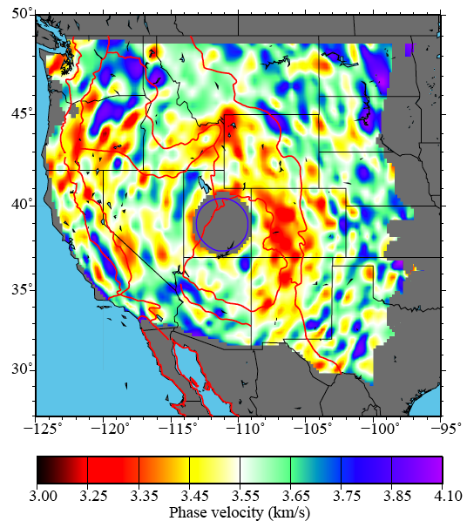
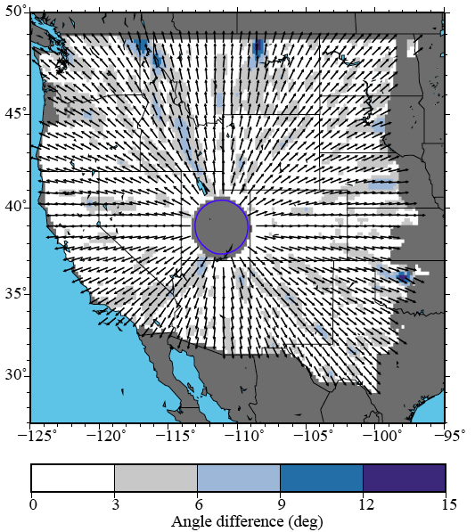
Localized Tomography: Eikonal Tomography
24 sec Rayleigh wave
phase speed
direction of propagation

Slide 40
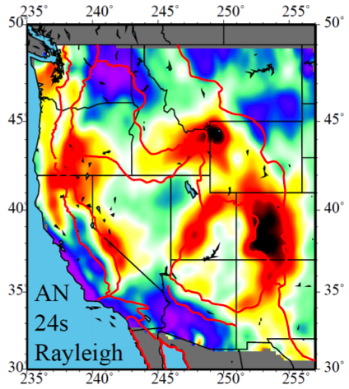
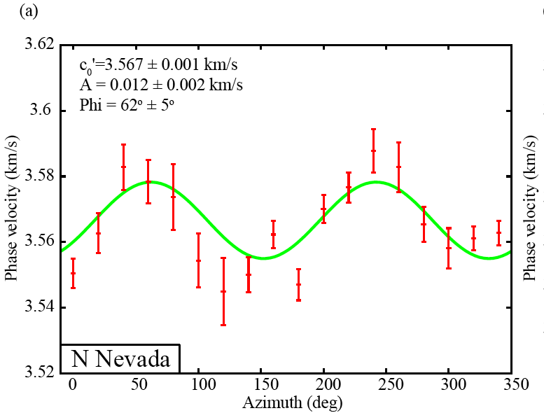
Localized Tomography: Eikonal Tomography
24 sec Rayleigh wave
phase speed

Slide 41
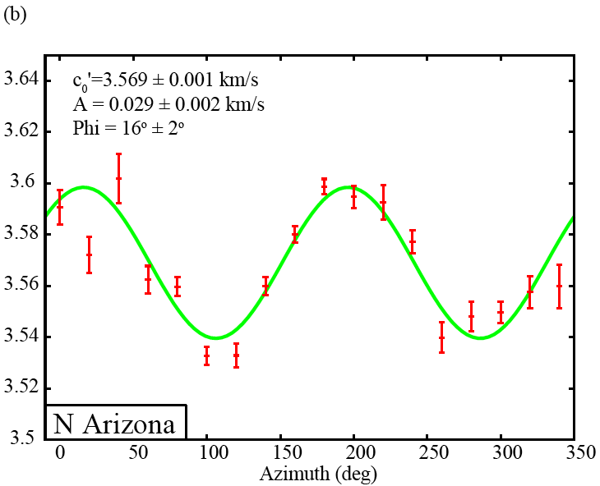
Localized Tomography: Eikonal Tomography
24 sec Rayleigh wave
phase speed

Slide 42
Travel Time Field τ(r)
Amplitude Field A(r)
60 s
Kuril Is Eq
7 Apr 2009
Ms = 6.8

Slide 43
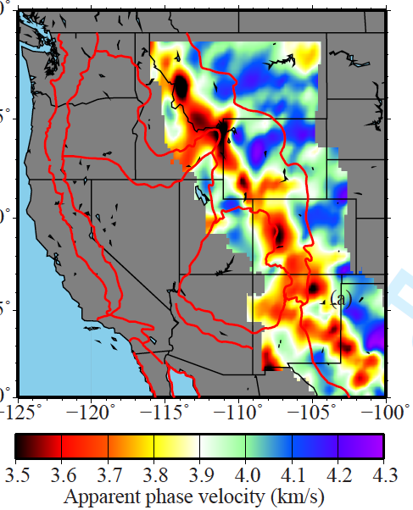
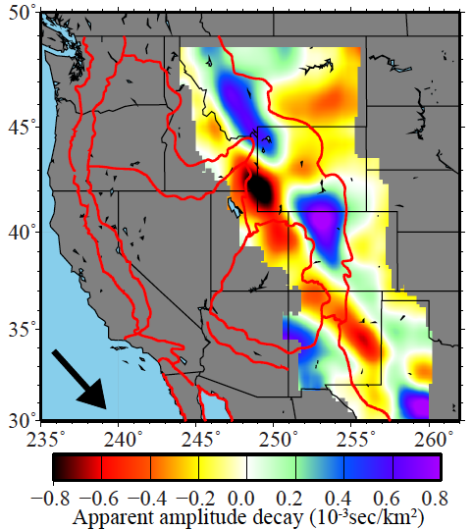
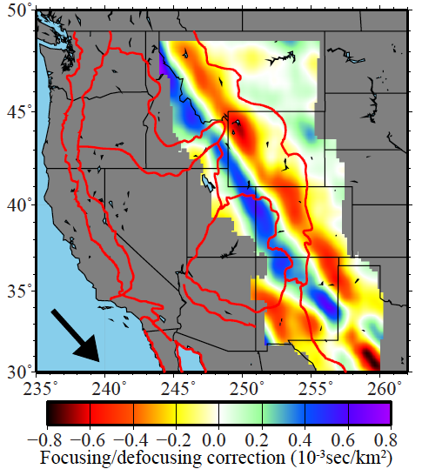
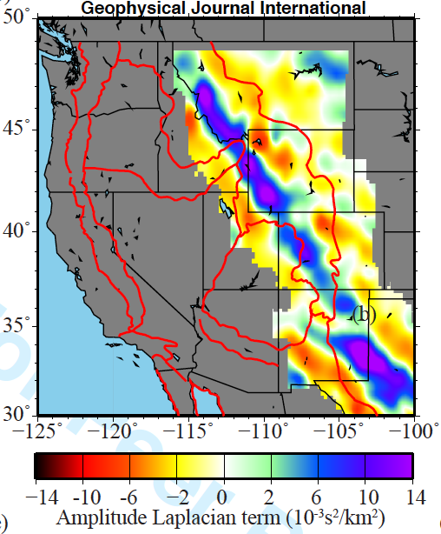
60 s
Kuril Is Eq
7 Apr 2009
Ms = 6.8
τ(r)
A(r)
|
-1
|
τ(r)
A(r) •
τ(r)
apparent phase
speed
apparent amplitude decay
τ(r)
A(r)/ω²A(r)
amplitude decay
correction
phase slowness correction
squared

Slide 44
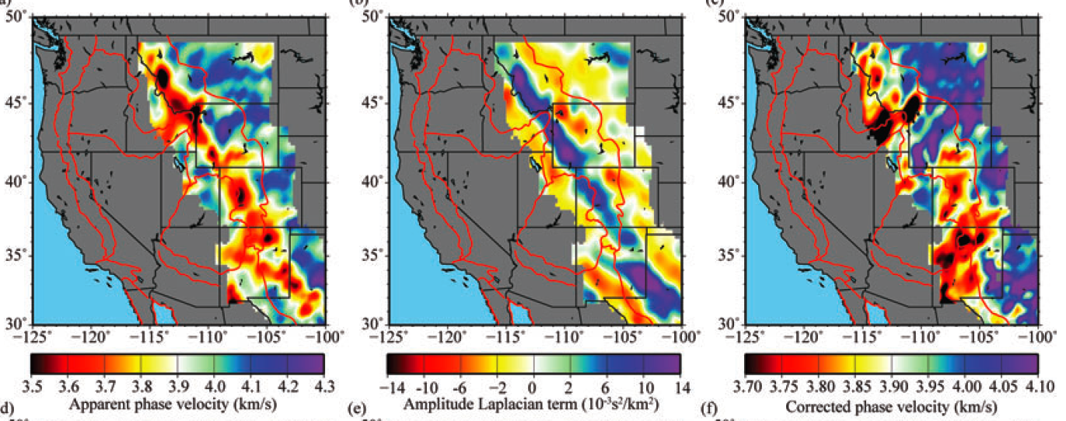
60 s Rayleigh wave
Kuril Is Eq, 7 Apr 2009, Ms = 6.8
-
=
Eikonal term:
geometrical ray theory
Finite frequency correction:
wavefront healing
focusing/defocusing
backscattering
Corrected phase
speed

Slide 45
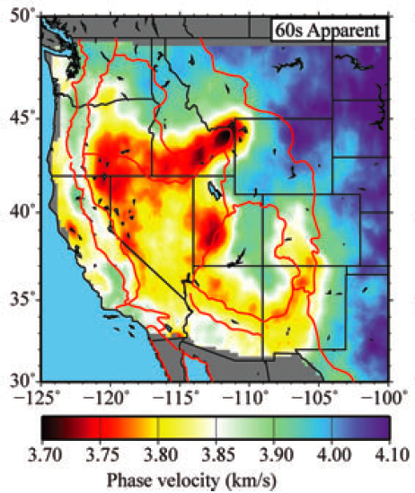

Slide 46
Effect of the “Finite-Frequency” Correction:
Isotropic structure: increases amplitudes & sharpen contrasts.

Slide 48
Effect of the “Finite-Frequency” Correction:
Isotropic structure: increases amplitudes & sharpen contrasts.
Anisotropic structure: reduces amplitudes & improves consistency across
periods.

Slide 49
Comparison of Ambient Noise & Earthquake Tomography
Ambient Noise
28 sec Rayleigh wave
Earthquakes
Eikonal
tomography
Helmholtz
tomography
Differences:
Some features differ in amplitude.
Edge effects in ambient noise map.
Differences typically lie within
uncertainties except near the edge
of the map.

Slide 50
Comparison of Ambient Noise & Earthquake Tomography
Ambient Noise
Earthquakes

Slide 51
“New” Methology:
Limitations:
monochromatic (instantaneous frequency) – different from what is measured.
a certain level of structural smoothness is assumed.
3-D wavefield effects are largely missing.
e.g., coupling to overtones, Rayleigh-Love coupling
application of differential operators to measured fields is noisy.
Strengths:
computationally fast.
simple to effect – travel time and amplitude fields are needed, with gradient
and Laplacian.
there is no actual inversion (no ad-hoc matrix damping, regularization, etc.).
it’s totally local – no lateral basis functions (e.g., spherical harmonics).
includes “finite frequency” effects and off great-circle propagation.
naturally generates uncertainty estimates.

Slide 52
3A. Some Results:
Joint Inversion of Receiver Functions and Rayleigh Wave Dispersion from Ambient Noise and Earthquake Data Using More Than 1000 TA Stations
Shen et al. (2012), GJI, JGR
3B. Some Results:
First Glimpses of the Mid-Continental Rift in the Crust and Uppermost Mantle.
Work in progress – Weisen Shen.

Slide 53
2. Improvements in surface wave methodology
Ambient noise tomography
Idea of the method – demonstrate with a simulation.
Quick overview of data processing.
Some plots of cross-correlations (empirical Green’s functions).
Derived observable: travel time fields.
B. “Flat Land” – new method to observe 3D structures from 2D arrays
Basic observables.
Localized inversion – eikonal, Helmholtz tomography.
Comparison of AN & EQ results.
C. Bayesian Monte Carlo Inversion

Slide 54
Receiver function analysis
Shen et al. (2012) GJI in press

Slide 55
Receiver function analysis: Harmonic Stripping

Slide 58
Example Result

Slide 59
Example Result

Slide 61
Example Result
A

Slide 62
Example Result
A

Slide 63
3A. Some Results:
Joint Inversion of Receiver Functions and Rayleigh Wave Dispersion from Ambient Noise and Earthquake Data Using More Than 1000 TA Stations
Shen et al. (2012), GJI, JGR
3B. Some Results:
First Glimpses of the Mid-Continental Rift in the Crust and Uppermost Mantle.
Work in progress – Weisen Shen.

Slide 64
4. Mid-Continental Rift
Superior Province Rift EarthScope Experiment (SPREE)
Stein et al. (2011), GSA Today

Slide 65
4. Mid-Continental Rift
Work by Weisen Shen

Slide 66
4. Mid-Continental Rift
Work by Weisen Shen

Slide 67
4. Mid-Continental Rift
Receiver Functions along the Rift
Work by Weisen Shen

Slide 68
4. Mid-Continental Rift
Work by Weisen Shen

Slide 69
4. Mid-Continental Rift
Work by Weisen Shen

Slide 70
4. Mid-Continental Rift
?
Work by Weisen Shen

Slide 71
4. Mid-Continental Rift
Work by Weisen Shen

